Slide 1



IBM DS0101EN
What is Data Science?
‹#›

Slide 2
‘’Every positive jump for humanity has been fuelled by intelligence.“

Slide 3
What is intelligence?
The ability for solving problems

Slide 4
What is artificial intelligence (AI) ?
Artificial Intelligence is a set of computer science techniques that allows computer software
to learn from experience,
adapt to new inputs
And complete tasks that resemble human intelligence.

Slide 5

Computing power is AI’s engine
Data is AI’s fuel
Algorithms are AI’s design
Why talk AI now?

Slide 6
Applications of AI
in Various Industries

Slide 7
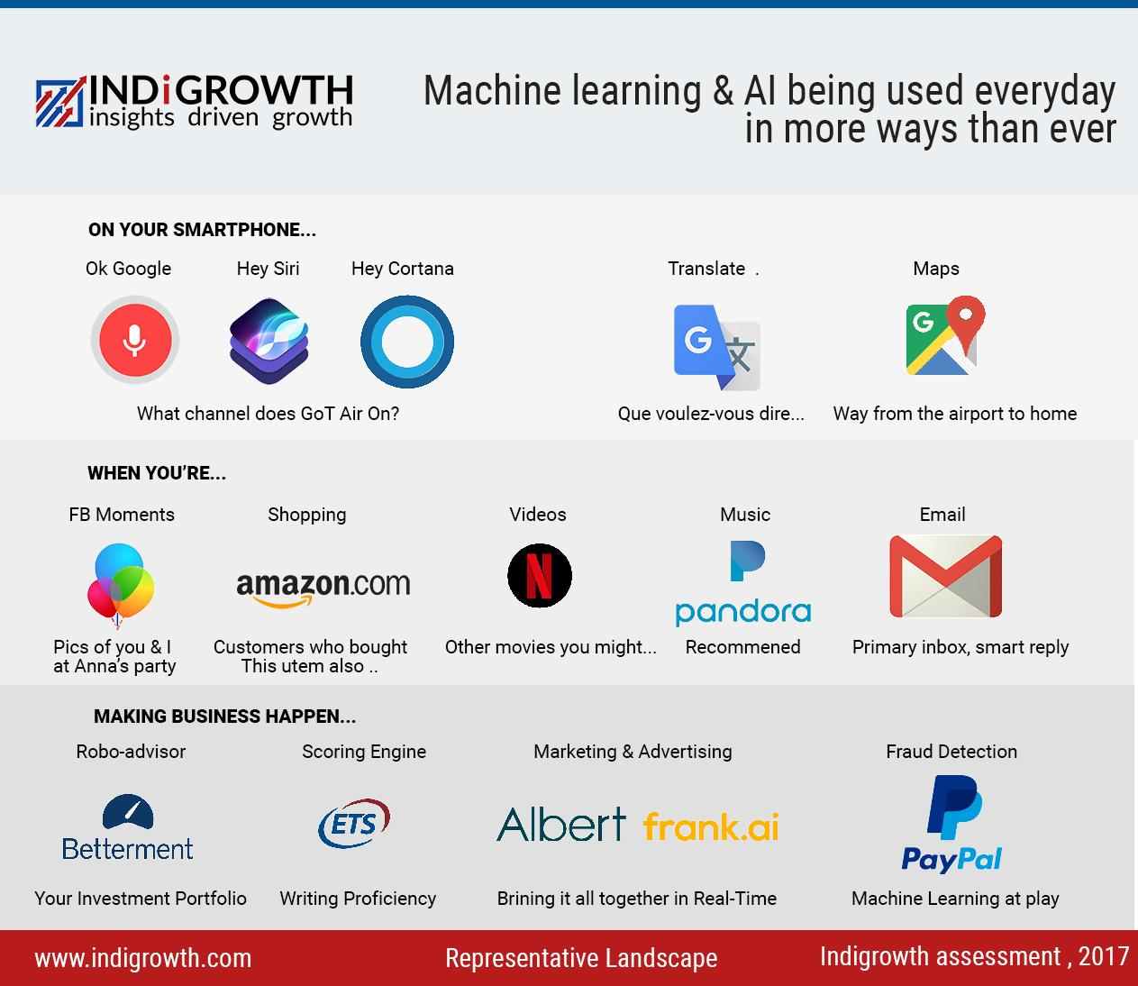

Slide 8
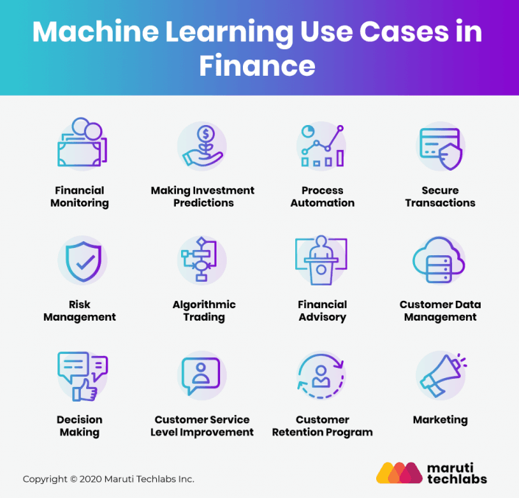

Slide 9
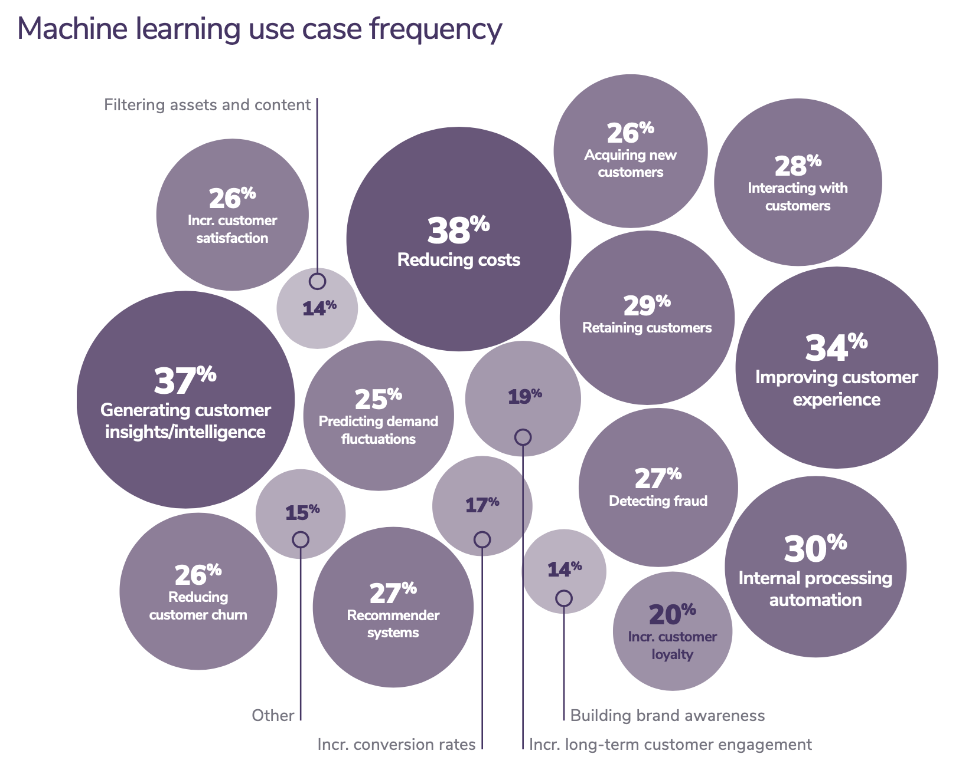

Slide 10

Group discussion
The Future of AI

Slide 11
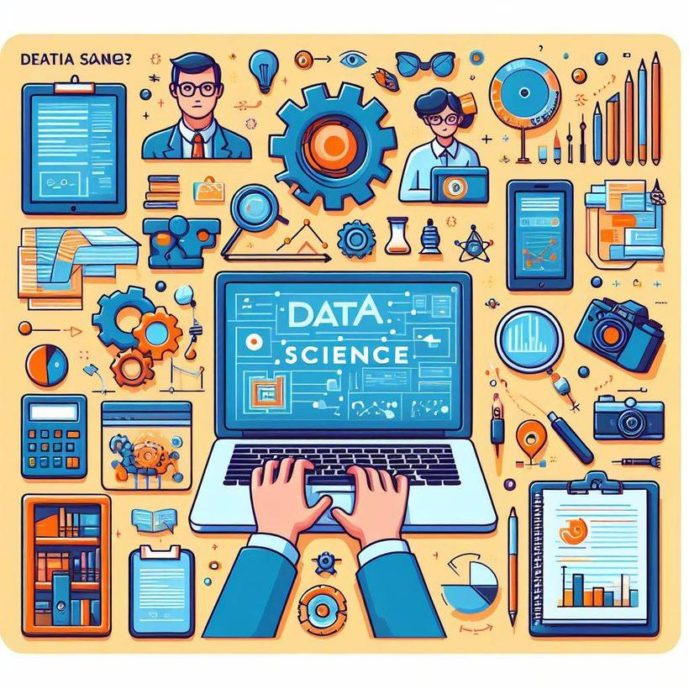
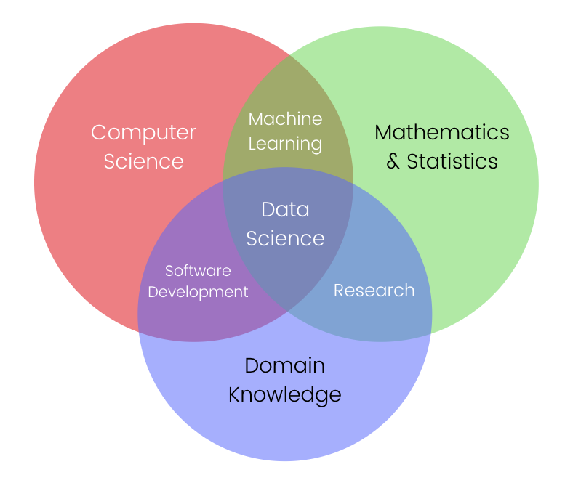
Understanding Data Science
4/28/2024
8

Slide 12
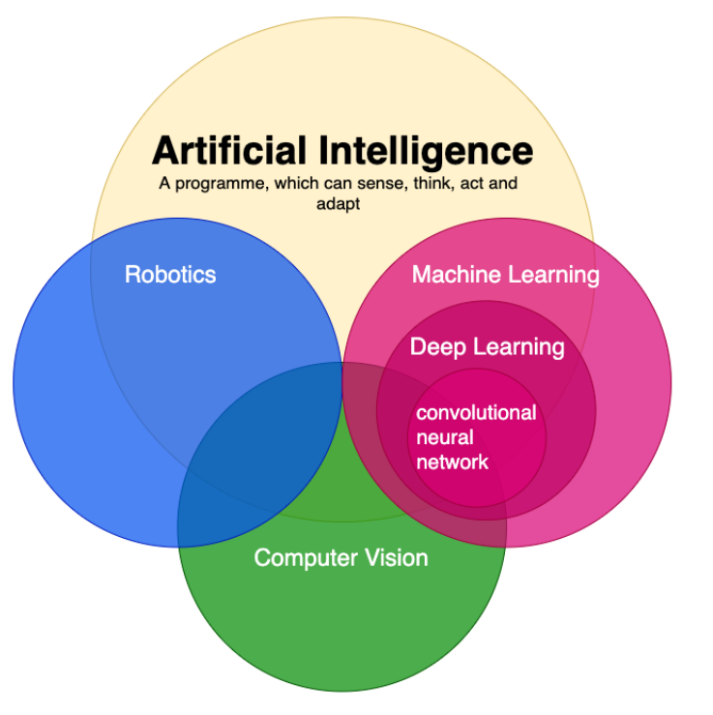
8:20 Break
NLP

Slide 13
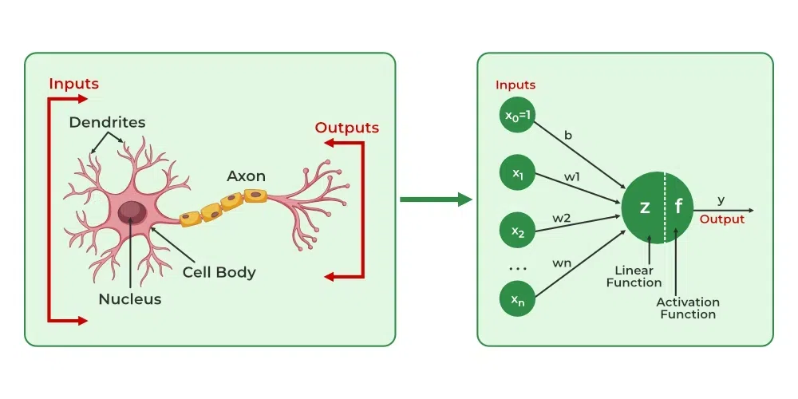

Slide 14
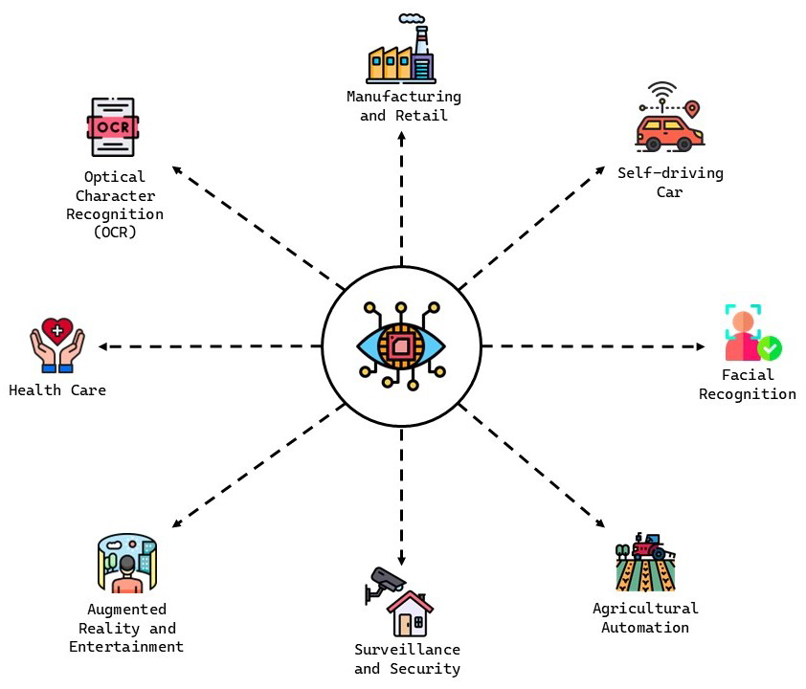
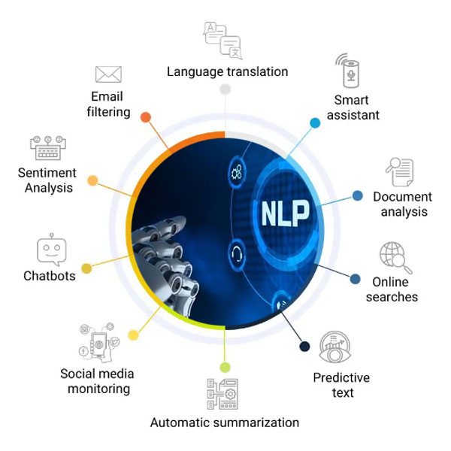

Slide 15

Understanding Data Science
Data is transformed into compelling narratives through storytelling.
These insights drive strategic decision-making for organizations.
It encompasses extracting and analyzing data in structured and unstructured forms.
4/28/2024
7

Slide 16

The Essence of Data Science
Data science explores, manipulates, and analyzes data to find answers.
Just as other sciences study specific subjects, data science focuses on understanding data.
Today’s world offers an abundance of data, algorithms, and accessible tools.
The affordability and accessibility of these resources make data science more relevant than ever.
4/28/2024
What is Data Science?
9

Slide 17

Fundamentals & Paths to a Career of Data Science
Learn Programming: Start with Python or R.
Understand Math and Statistics: Basics of linear algebra and statistics are essential.
Data Understanding (Data Analysis, Visualization and Exploration)
Data Preprocessing and Cleaning
Machine Learning: Learn basic algorithms like Linear Regression and Decision Trees.
Real Projects: Participate in projects or competitions like Kaggle.
Continuous Learning: Keep up with new courses and research.
Choose a Specialization: Focus on a specific field like financial analysis or healthcare
Communication and Interpretation.
4/28/2024

Slide 18
The Data Scientist Job Market
4/28/2024
18

Slide 19
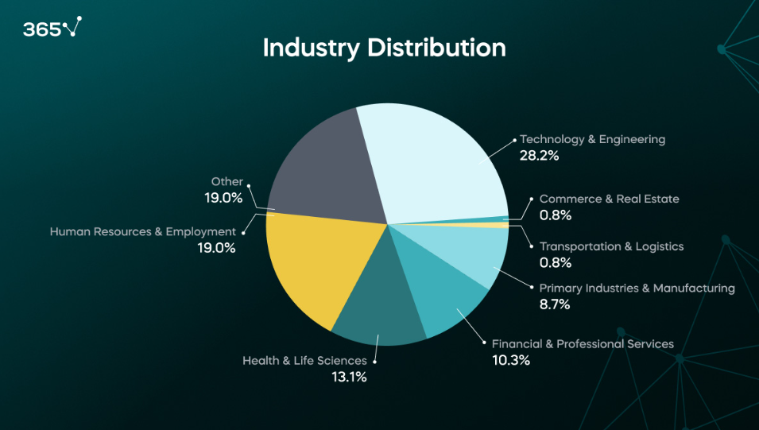
The Data Scientist Job Market in 2024 [Research on 1,000 Job Postings]

Slide 20
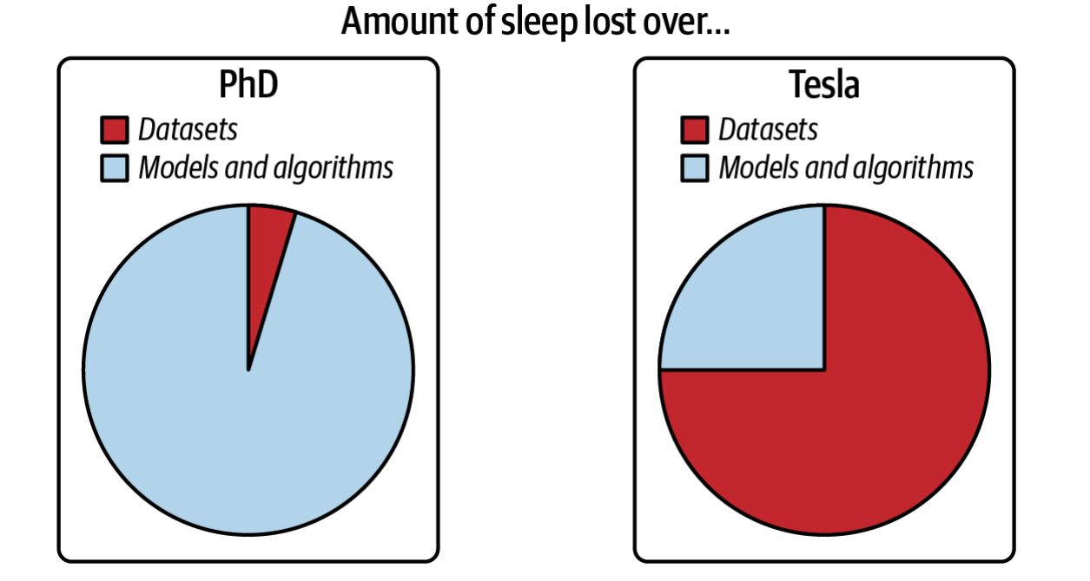
Data in research vs. data in production
Andrej Karpathy (Former Director of AI at Tesla)

Slide 21

AI in production: expectation
Collect data
Work in Data
Train model
Deploy model

Slide 22
AI in production: reality
Choose a metric to optimize
Collect data
Work in Data
Train model
Realize many labels are wrong -> relabel data
Train model
Model performs poorly on one class -> collect more data for that class
Train model
Model performs poorly on most recent data -> collect more recent data
Train model
Deploy model
Dream about $$$
Wake up at 2am to complaints that model biases against one group -> revert to older version
Get more data, train more, do more testing
Deploy model
Pray
Model performs well but revenue decreasing
Cry
Choose a different metric
Start over
Step 16 and 18 are essential
Notes:
baraa slide

Slide 23
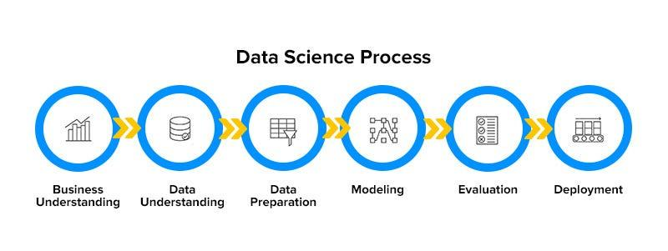
The Data Science Process
4/28/2024
Fundamentals of Data Science
14

Slide 24
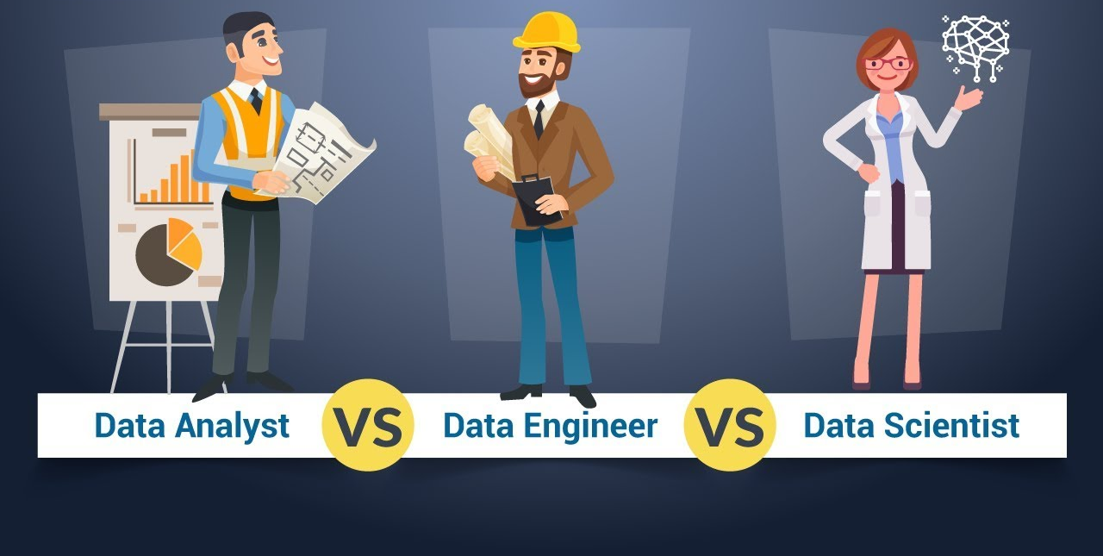
Data Different Jobs

Slide 25
Data Scientist VS Data Analyst VS Data Engineer VS Machine Learning Engineer
Data Analyst:
Think of a Data Analyst as a detective who is always investigating, "What happened, and how can we improve things?"
Data Engineer:
Think of a Data Engineer as the engineer who builds the pipelines that deliver clean water (data) to everyone.
Data Scientist:
Think of a Data Scientist as the explorer guiding the ship into the unknown, always asking, "What can I discover in this data?"
Machine Learning Engineer:
Think of a Machine Learning Engineer as the engineer who turns theoretical designs into reality, making machines work intelligently in the real world.

Slide 26
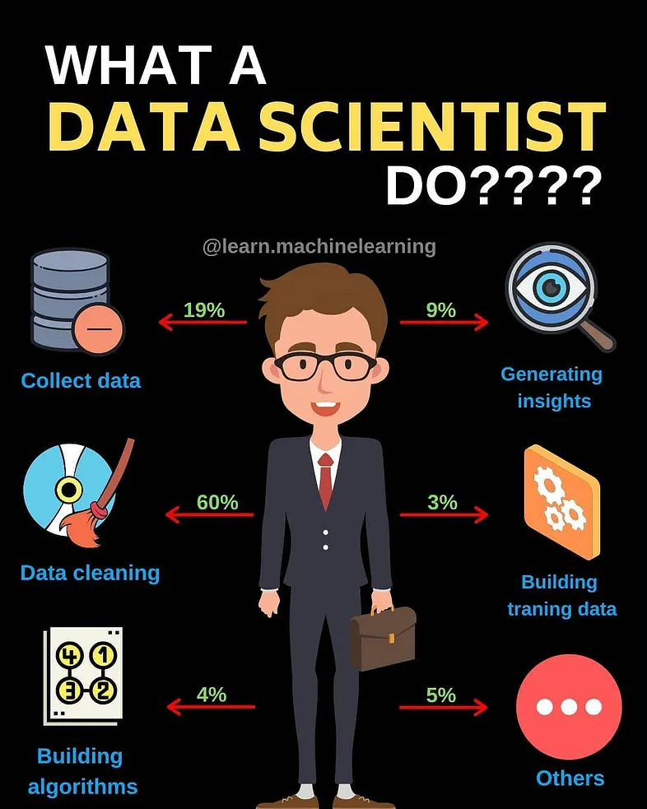
What Data Scientists Do

Slide 27
My Advice for New Data Scientists
Use curiosity to fuel problem-solving
Master the basics
Work on real projects
Embrace failure
Learn to tell the story
Never stop learning
Build your network
Be adaptable
Focus on quality, not just quantity
Always think about added value
Be solution-oriented, not tool-oriented
Share your work and learn from others
24

Slide 28













Data Scientist Skills
Programming Skills
Domain Knowledge
Communication
01
Proficiency in languages like Python, R, or SQL for data manipulation and analysis.
03
Understanding of the specific industry or domain to interpret data in context.
05
Effectively communicating findings and insights to stakeholders through reports and presentations.
Data Analysis
Data Visualization
Problem-Solving
02
04
06
Ability to analyze large datasets using statistical methods and machine learning algorithms.
Creating visual representations of data to communicate insights effectively.
Applying analytical skills to solve complex business problems using data-driven approaches.

Slide 29
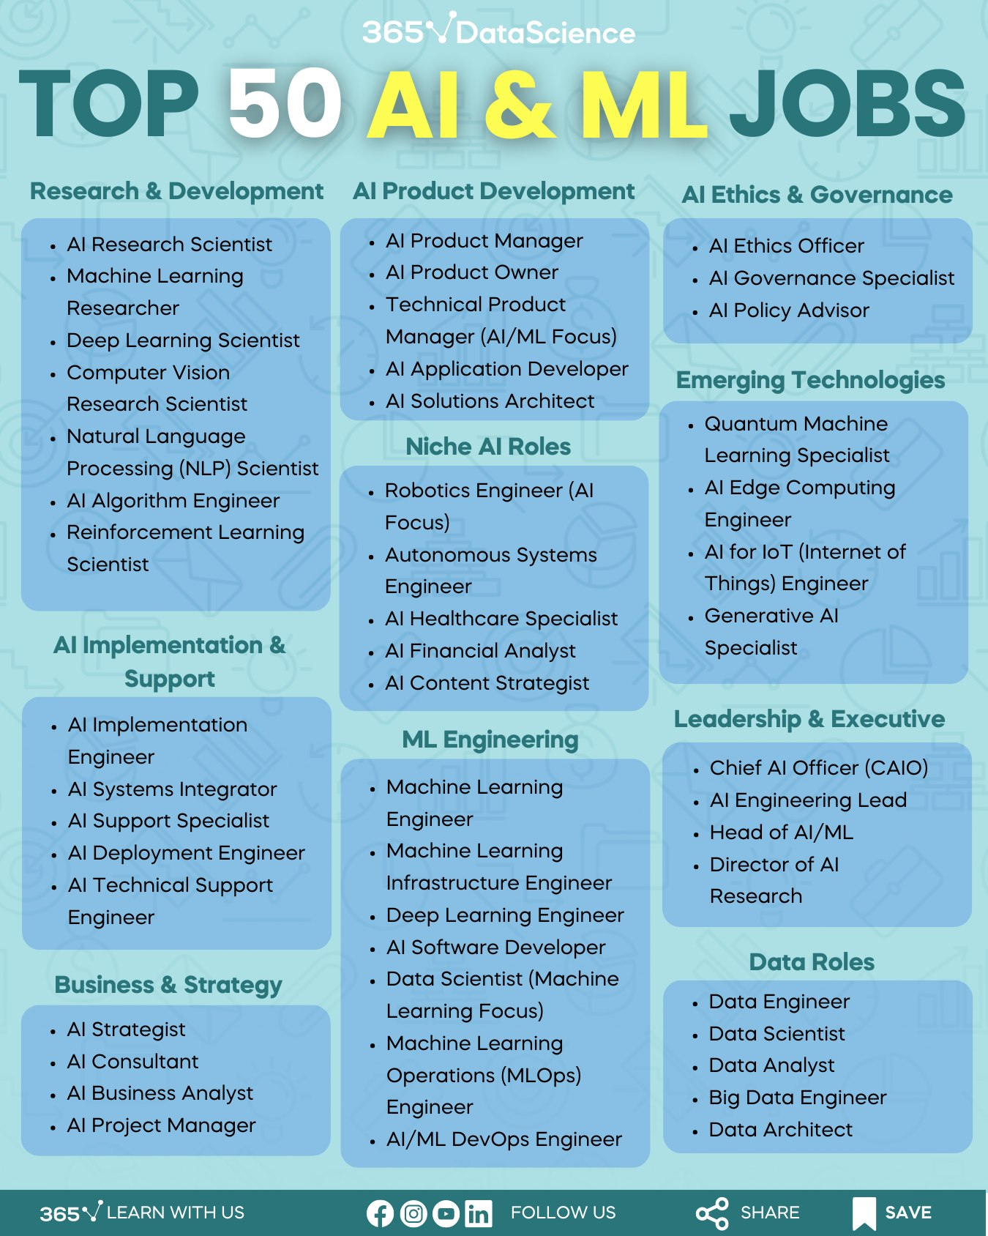

Slide 30





Big Data
Volume
Variety
Velocity
Dealing with large volumes of data that traditional systems cannot handle efficiently.
Handling diverse data types such as structured, semi-structured, and unstructured data.
Processing data streams in real-time or near real-time to derive timely insights.

Slide 31



Big Data
Veracity
Value
Tools & Technologies
Ensuring data quality and reliability in a big data environment.
Extracting actionable insights and value from big data for business decisions.
Using platforms like Hadoop, Spark, and cloud services for big data processing and analytics.

Slide 32
Harnessing Big Data
Value: Ability to derive value from data beyond profit, including social and personal benefits.
Examples of V's in Action: YouTube uploads, world population's digital interactions, data types.
Coping with Big Data Challenges: Traditional tools insufficient, alternative tools like Apache Spark and Hadoop.
Distributed Computing Power: Tools enable extraction, loading, analysis, and processing of massive data sets.
Enriching Services: Insights from Big Data allow organizations to better connect with customers.
Personal Data Journey: From devices to Big Data analysis, data impacts services and returns to users.

Slide 33
Understanding Different Types of File Formats
4/28/2024
31

Slide 34
Understanding File Formats
File formats are the different structures and encoding methods used to store and organize data in a digital file. The choice of file format directly affects how data is stored, retrieved, and processed. Different file formats serve various purposes, from simple text storage to complex data structures used in machine learning and big data applications. Below are key reasons why understanding file formats is important:
Compatibility: Ensures that the data can be read and processed across different programs and systems.
Efficiency: The right file format can reduce storage space and increase processing speed.
Data Integrity: Helps maintain the structure and accuracy of the data during transfer or sharing.
Choosing the appropriate file format is crucial for ensuring data is handled properly, whether you're working on small data sets or large-scale projects. Let's take a look at a few commonly used file formats in data science.
4/28/2024
Understanding Different Types of File Formats
32

Slide 35

Overview of File Formats
CSV (Comma-Separated Values)
Description: A simple text-based format used to store tabular data where values are separated by commas.
Development: An older, widely-used format for exchanging data between different systems.
Features: Maintains a structured layout that's easy for both humans and machines to read, and can be opened in text editors or spreadsheet programs like Excel.
Advantages: Lightweight and easy to handle, ideal for structured data like tables.
Common Use: Used for storing organized data such as sales records, survey results, or data transferred between databases and analytical tools.
4/28/2024
Understanding Different Types of File Formats
34

Slide 36
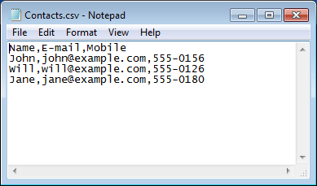
Example of File Formats
The below image shows a CSV file which is opened in Notepad.
4/28/2024
36

Slide 37
Overview of File Formats
JSON (JavaScript Object Notation)
Description: A lightweight, text-based format used for representing structured data as key-value pairs.
Development: Originally derived from JavaScript, now widely adopted across different platforms and languages.
Features: Human-readable and machine-parsable, supports hierarchical and nested data structures.
Advantages: Flexible, easy to work with, especially for APIs and data exchange between web applications.
Common Use: Commonly used for transmitting data between a server and a web application, and for storing complex structured data like user profiles, configurations, and API responses.
4/28/2024
Understanding Different Types of File Formats
35

Slide 38
Overview of File Formats
XLSX:
Microsoft Excel's Open XML format.
Data is organized into worksheets (rows and columns).
Supports formulas, charts, and data manipulation.
Widely used for data analysis and reporting.
XML:
A markup language designed to encode data.
Both human- and machine-readable.
Often used for data exchange between systems and applications.
Flexible and customizable structure for storing and transmitting data.
4/28/2024
Understanding Different Types of File Formats
33

Slide 39
Overview of File Formats
PDF:
Developed by Adobe for consistent document presentation.
Maintains formatting across different devices and platforms.
Ideal for sharing documents where layout, fonts, and images must remain intact.
Commonly used for reports, contracts, and presentations.
4/28/2024
Understanding Different Types of File Formats
34

Slide 40
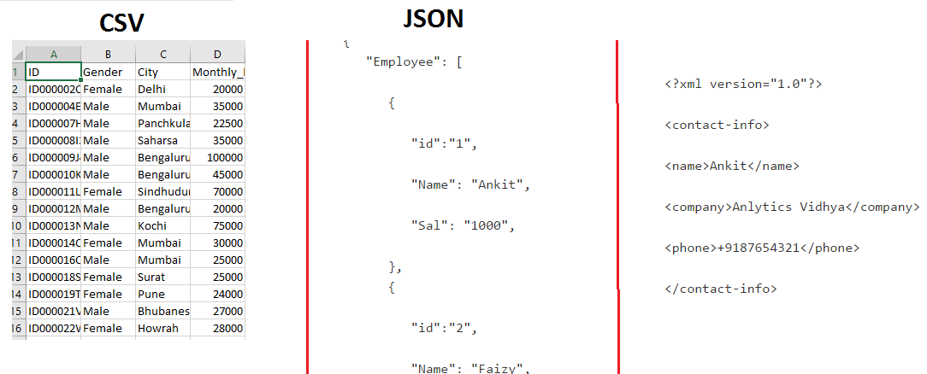
Example of File Formats
4/28/2024
36

Slide 41
Q & A
4/28/2024
Q & A
37

Slide 42
Thank you!
4/28/2024
38

